Slide 1
DIY Arduino ML for RT-MMI
(supplementary)
Mikhail Sintsov
Head of Human-Machine Interfaces at Motorica LLC

Slide 2
mBed AI
mBed AI (embedded artificial intelligence) — Machine learning (or AI) algorithms running on autonomous devices, usually microcontrollers, or FPGA, or specialized SoCs.

Slide 3
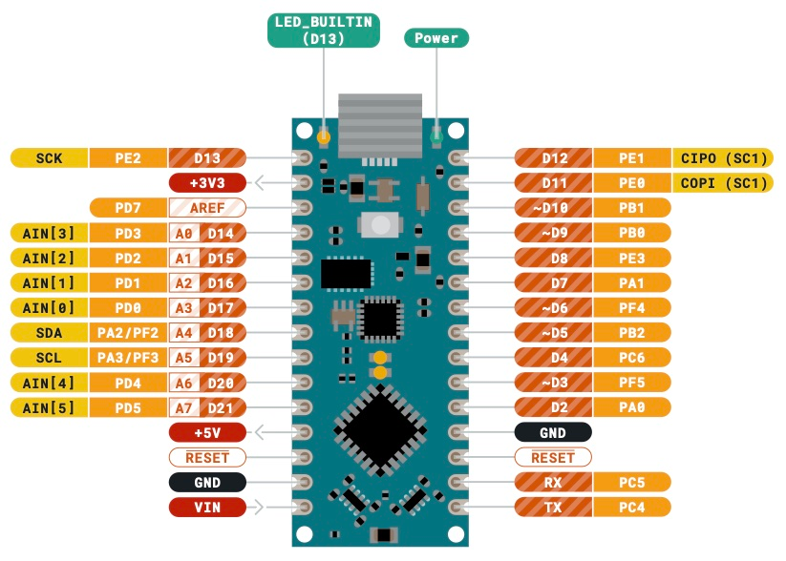
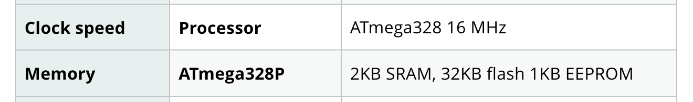
mBed AI
mBed AI (embedded artificial intelligence) — Machine learning (or AI) algorithms running on autonomous devices, usually microcontrollers, or FPGA, or specialized SoCs.

Slide 4
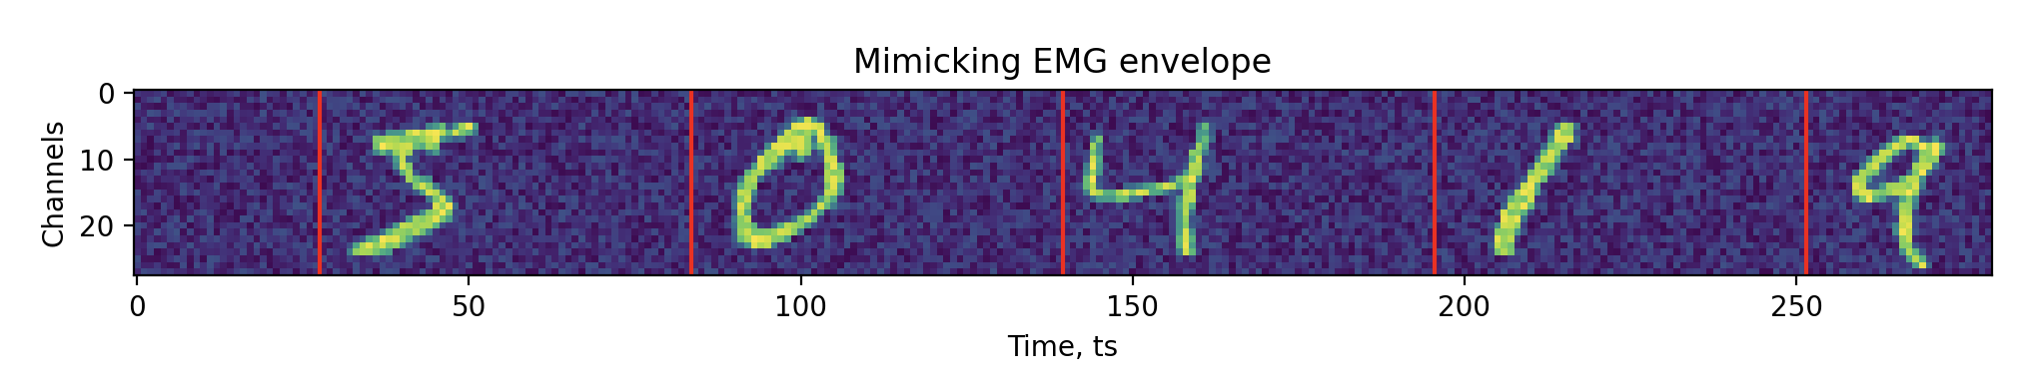
About dataset
Mimicking envelope calculation of EMG gesture epochs

Slide 5
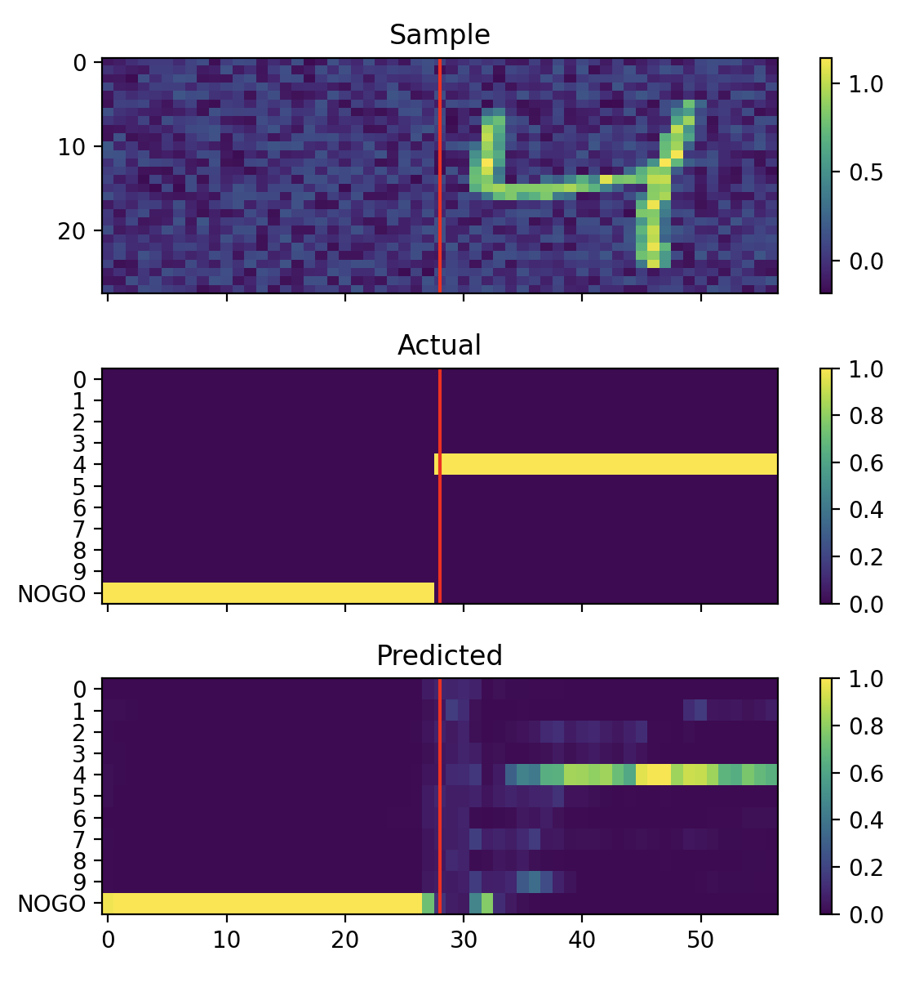
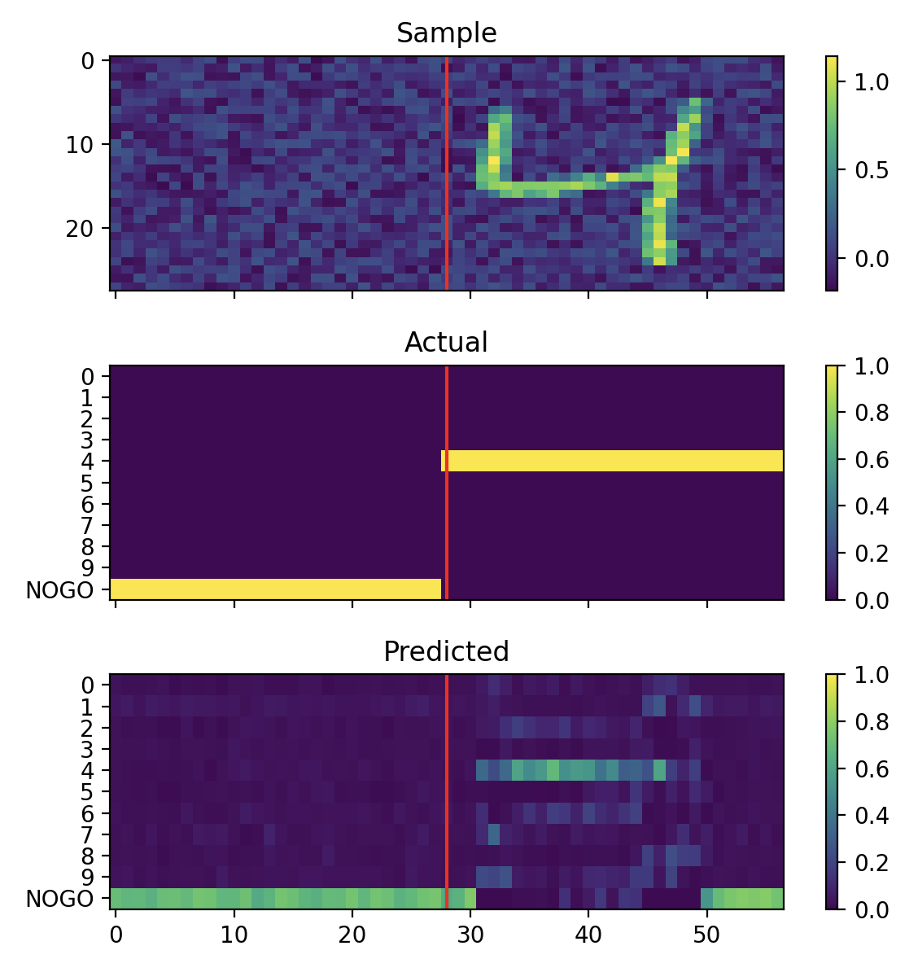
Regularization
No regularization
With regularization

Slide 6
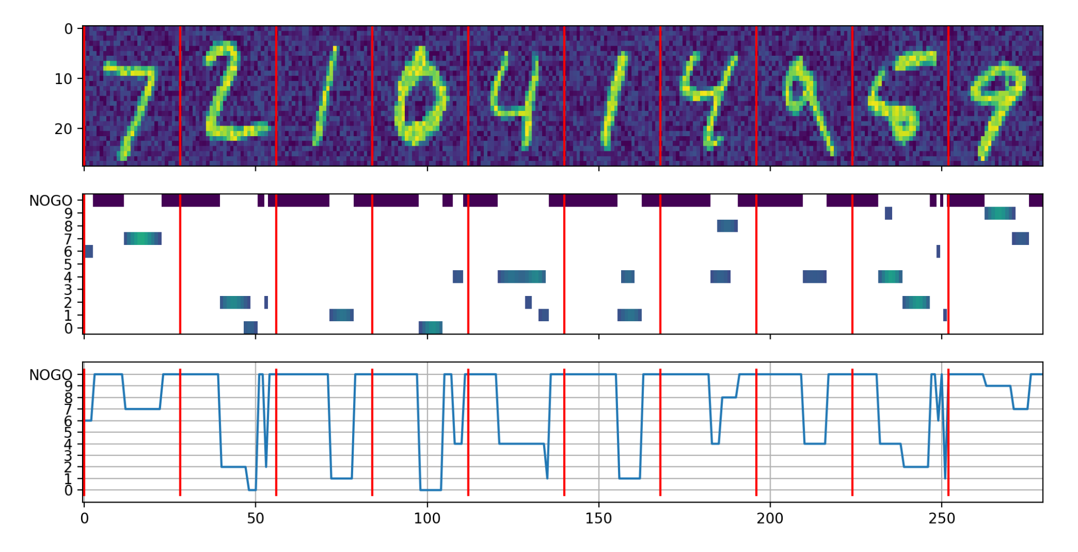
Mimicking sliding inference

Slide 7
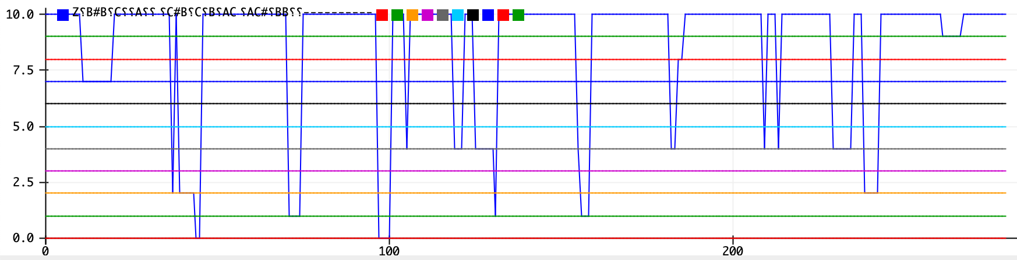
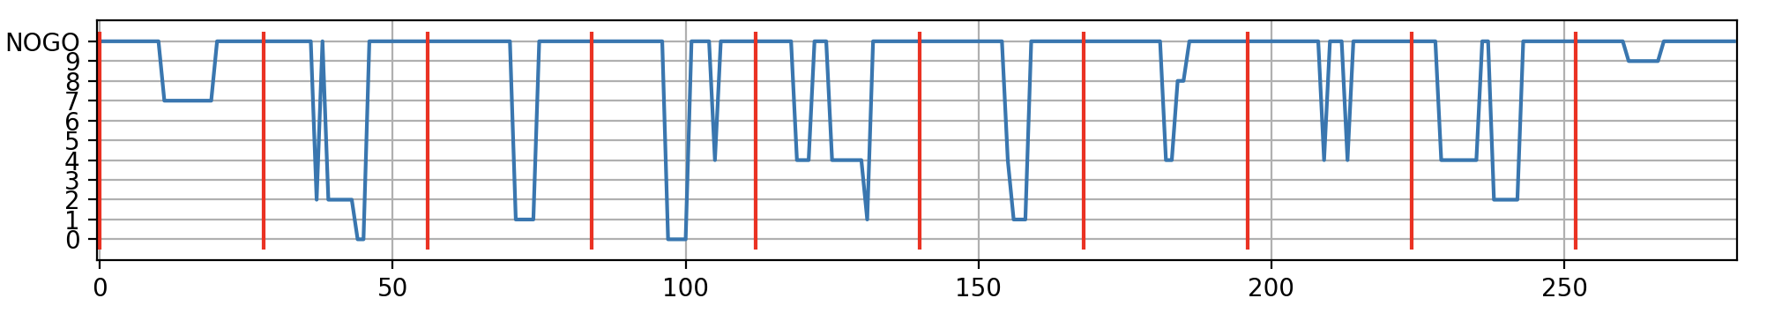
Compare!

Slide 8

Compare!

Slide 9
Homework
Walk through the tutorial
Download Arduino IDE and compile the sources (no need to run on a board)
Modify pipeline, decrease loss and create Numpy pseudocode for porting
*** (for pros) Add single 1d-conv layer before RNN and port it to C/Cpp (you can take arduinos if you will)

Slide 10
Next steps?
Try on your own
Check up this projects:
MicroMLGen = basically sklearn weights with jinja2 templates
TinyML = TFLite + some magic
Platforms:
Arduino
ESP32 — strong community, high core speed
STM32 — Floating point calculations unit (some), high core speed
RPi zero W (2) - Linux + GPIO + periphery

